Slide 1
CQRS, DDD, Domain Events and Event Sourcing PART 1.
Anjam Tahir
Presentation Date ???
Notes:
This presentation is based on learning from a course that myself, Matt C and Tom S attended a couple of weeks ago in London by a guy called Greg Young.
Greg Young is probably the current expert in applying this pattern to many applications that he has designed/implemented.
The three days where quite intense and also introduced some really interesting concepts.
The concepts do not mean that we need to un-learn everything that we have been doing in the past with regards to building web application or web application solutions.
The CQRS pattern is an alternative that solves specific problems that are mainly associated with building applications that need to cope with very high transactional throughput and that are required to scale out easily.
Hopefully this presentation will help everyone understand the concepts/pattern(s) behind implemented a system that is based on the CQRS pattern.

Slide 2
What is CQRS?
CQRS is not an architecture.
CQRS is a pattern – it offers us…
Segregation of read operations from the write operations.
Scalability of read/write sides independently.
Notes:
So what is it all about:
Command Query Responsibility Segregation is a pattern that can be applied to application architecture to separate the write side from the read side.
By doing so we are in a better position to scale each side independently of the other.
For example we may find that the amount of work the system is doing when it is trying to read data from a data store far outweighs the amount of work the system does if it tries to write data to the data store.
This can be best explained by walking through a series of examples that take an existing system and evolving it to use the CQRS pattern.

Slide 3
Stereotypical Architecture
3NF – Database (RDBMS)
Client interaction: normally this consists of the client sending/receiving DTOs up and down the different layers of the system.
The application services normally return back an acknowledgement or a list of errors back to the client.
ORM
Domain (DTOs)
Application Services
Remote Facade
Client
Notes:
So how can we do this.
This can be explained by walking through a series of example that take an existing system (Stereotypical Architecture) and migrating it towards the CQRS pattern.
This usually consist of a 3NF Database that contains most if not all the data that is required to run the application and also maintain the current state of the system.
How do we get data out of this system?
Typically to get data back out of this type of database generally requires complex queries that need to perform multiple joins across many tables to bring back data that can then be mapped into an object model representation.
The data represents the current state of the application.
This type of architecture normally has an ORM layer, something like Nhibernate or Entityspaces that maps the data from the database to and from a so called Domain Model to some internal representation of the data that normally tries to model the 3NF database model.
The mapping that takes place within the ORM usually will consist of a copy of an object model representation of the database model and the data that is being persisted.
Deltas are determined by the ORM and persisted to the database.
This in itself adds consideration complexity and also performance overheads.
It also introduces object-relational impedance mismatch between the object model representation of the data in code and the database model.
The so called domain model usually consists of an object graph that consists of by enlarge a sets of DTOs with getters/setters and not much behaviour or business logic.
This is not really a Business Driven Domain model and is referred to as an Anaemic Domain model.
Domain models should really consist of associated behaviours that a domain exhibits and should never just be a set of objects that have a series of getters/setters with no behaviour.
The business logic or rules tend to end up in many places such as the application services layer or even the client application itself.
This architecture is basically a CRUD based system which essentially deals with the Create, Read, Update and Delete operations.

Slide 4

Migrating to CQRS

Slide 5
Stereotypical Architecture
3NF – Database (RDBMS)
Client interaction: normally this consists of the client sending/receiving DTOs up and down the different layers of the system.
The application services normally return back an acknowledgement or a list of errors back to the client.
ORM
Domain (DTOs)
Application Services
Remote Facade
Story: A Person wants to make a Reservation for a football game
As a person wanting to go to a football match
I want to make a reservation
So that I can watch the game.
Client
Notes:
Lets begin with the Application Service Layer and take a typical story that has been implemented in the stereotypical architecture in a application service called the ReservationService that Implements an Interface called IReservationService.
So this is a really simple example.

Slide 6
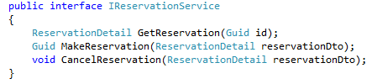
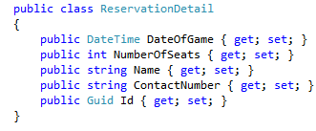
Read/Write on the same Interface
Notes:
What do we see here?
CQRS Sample1
We have a typical service that has a set of operations that use a DTO called reservation details to pass data back and forth.
This is quite typical, the service has operation for both read and write on the interface.
We could go on and extend this interface to have many more operations associated with dealing with reservations.
But what direction are we heading towards,
Losing the users intent
Coupling interface (i.e. use cases) by sharing the common DTO
Basically we are heading towards the traditional CRUD based approach
So how can we start to move this towards a CQRS pattern based approach.

Slide 7
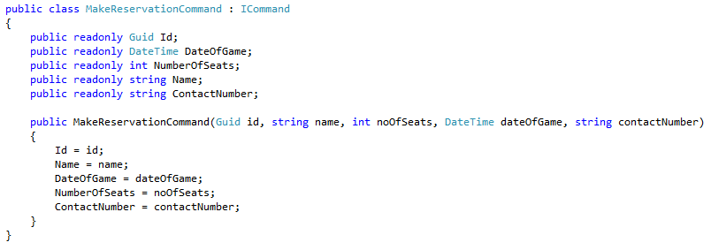
Bringing the intent of the user forward
Take our DTO and rename it with the Command prefix
Notes:
So how can we bring forward the users intent? Refactor Sample 1 towards using a Command based approach.
CQRS Sample 2
Introducing commands.
By using commands we can also start to segregate the responsibilities of read/write.
So let look at this interface again with particular focus on the MakeReservation method.
Refactor interface to commands.

Slide 8

Bringing the intent of the user forward
Using command(s) helps us to show the users intent on a use case by use case basis.
Notes:
If we look back at our interface for the reservation service we can see that we could actually begin to refactor the service so that it accepts a different type of object instead of a DTO.
We could encapsulate the intent of the user in a command.
A Command is just another light weight object that just contains enough of the data require to perform the required behavior.
Which in this case is making a reservation to a football game (refer back to the user story).
Note that we have completely omitted the GetReservation method that was on our origional IReservationService interface.
Why?
We have intentionally remove this because we are focusing on our write side.
The GetReservation method is a query and belongs on the query side which we will return to later on when we start looking at the read side.
Can we refactor this further?
We can now take a good look at our Reservation Service, could we generalize this further
By having a command interface for commands – say ICommand
By having a single Handle method that allows us to execute commands.
Refactor to Command Handler Sample 2 -> Sample 3
What does this mean, Refactoring our way towards a command Hander.

Slide 9
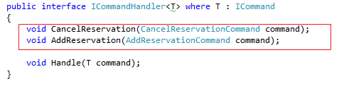
Bringing the intent of the user forward
By further refactor we can extract out a command interface for a command handler
Now our application service, the reservation service becomes a CommandHandler for a specific command.
Notes:
So what is our application service starting to look like now?
Since each of our commands implements the ICommand interface, which is just a maker interface for Commands.
This use of this marker interface allows us to make use of generics and refactor our IReservationService.
If we rename the IReservationService to ICommandHandler that accepts a Type constrained to an ICommand we end up with what is shown on the above side.
We remove,
CancelReservation
AddReservation
methods and create a single method called Handle that return void and accepts a type that implements the ICommand interface.
i.e. any commands

Slide 10
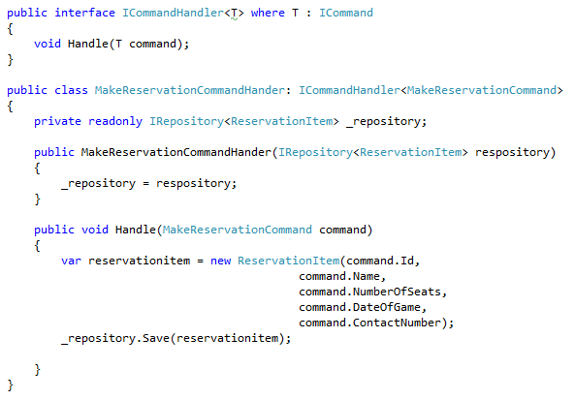
Reservation Service to Reservation CommandHander
The intent of the user has been brought forward and represents the use case.
Notes:
With the generalized ICommadHander interface we are now in a position to implement custom command handlers for each of our commands.
The intent of a user of the application is brought forth, as mentioned.
This will become a fundamental concept that we need to start to get familiar with right now.
We are now moving towards a design that is based on behavior instead of the stereotypical architecture CRUD approach (i.e. The approch based on data) that was mentioned earlier.
Mention something about the repository.
Sample 3 – Refactoring towards a command handler
Lets just recap on commands and command handlers so far.

Slide 11
Commands and Command Handers
Command(s)
Show the intent of user on a use case by use case basis.
E.g. the
Command(s) are nouns and represent an action that needs to take place.
Command Handler(s)
Invoke the Domain
Coordinating the domain objects and invoking the necessary behavior
Perform validation that is required on the command.
There is a one-one Command/Handler mapping.
Notes:
The command object show the intent of a user and we usually have a single command for a single use case.
The command handlers coordinate the domain objects by the use of a repository that is used to retrieve the necessary domain objects.
The responsibility of the command hander is to
Perform any validation that is required on the command
Coordinate the domain objects and invoke the necessary behavior on the command
Sample 3 -> Sample 4 Refactor command handler to throw an exception to the client to indicate a validation error.
So where are we heading?
Let just reflect back at our stereotypical architecture for a moment.

Slide 12
Migrating to CQRS
3NF – Database (RDBMS)
3NF – Database (RDBMS)
ORM
ORM
Domain (DTOs)
Domain
Application Services
CommandHandlers
Remote Facade
Remote Facade
Execute commands
Client
Client
Notes:
Instead of the application services dealing with just sending DTOs back and forth we now have replaced the application services with a series of command handlers that accept specific commands (these show the intent / behavior of the use case).
The command handlers are responsible for coordinating the relevant behaviors on the domain model associated with the command that is being handled.
At this point we will begin to see that our domain model is not just a set of DTOs with a series of getters/setters but a model that actually reflects users intent and behavior and needs to be given some considerable thought.
Sample 4 Command, CommandHandler and also emerging Domain object called ReservationItem.
We are stepping in to the Domain and this area of the application is so important it worth pausing here and looking at what Domain Driven Design is and how it should be used to arrive at a Domain Model that represents the Business Domain.
In the example we have arrived at a Domain Object that represents a Reservation Item.

Slide 13
Domain Driven Design (DDD)
DDD is all about design and creating highly expressive models of the business Domain.
It is concerned with understanding the different contexts within an organization and modeling representations of how the data is viewed.
Based on arriving at a common language that can be understood by all including non-developers.
This common language is called the Ubiquitous Language.
Notes:
Domain Driven Design is tough.
Its not easy and it takes a lot of analysis to get to a point where you have highly refined domain model that reflects the behaviors in your business domain.
So what is it and where do you start?
The Domain model can be build in an iterative manner by playing games such as analysis/code. i.e. we get the domain experts in to a room with a bunch of developers for 60 minutes to tell us everything they know about the domain. The they leave and the developers spend the rest of the day coding the domain model. The next day the domain experts are invited back for another 60 minutes to go over the Domain model again. They leave and the developers code and so on until we arrive at a refined Domain model this is Domain Driven Design.
Lets run through some of the key concepts of Domain Driven Design

Slide 14
Domain Driven Design (DDD)
Modeling the Domain
Entities
Are objects that have a unique identity. They are unique
e.g. Vehicle’s uniqueness is identified by its Registration No.
e.g. Bank Account has a unique account No.
Value Objects
Are objects do not have an identity
They are immutable.
They should be thin and simple
They can encapsulate attributes of an Entity that expresses a concept that has meaning within the Domain.
Is my object an entity or value object?
It depends on your specific context!
Notes:
Example of customer buying a pint of milk from the store.

Slide 15
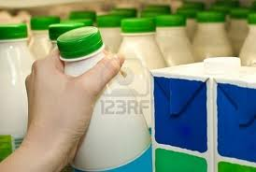
Entity or Value Object?
A customer buys milk from the store
Is the milk an entity or a value object?
Does it matter which milk carton the custom selects?
Notes:
Example of customer buying a pint of milk from the store.
In this use case we have a customer that buys a carton of milk from a store.
Can we identify the entities and value objects here?
Customer - Entity
Milk - Value Object
Store - Entity
What happens when the store discovers that there is a batch of milk that is faulty and has to be removed from the shelves and sent back to the provider?

Slide 16
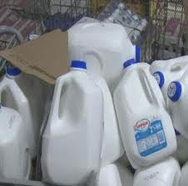
Entity or Value Object?
A milk Provider recalls a batch of milk from the store.
Is the milk an entity or a value object?
Does it matter which milk carton the store recalls?
Notes:
Let’s now suppose that a milk provider recalls a batch of milk.
It is very important for the milk provider to identify which batch of milk is faulty or not safe for consumption.
In this context the item of milk will have a specific identity that will allow the store to determine which batch the milk belonged to.
In this case the milk becomes an entity with and identity.
So what have we learnt – The Context within which we are working is very important!

Slide 17
Domain Driven Design (DDD)
Modeling the Domain
Aggregate(s)
Is a collection of entities and value objects.
Defines object ownership and object boundaries.
Group of objects that is considered as one unit with regard to data changes.
Transactional consistency (logical unit of work).
Time is an important element when modeling aggregates
Aggregate Root
Entities can be parts of an Aggregate or they can be an Aggregate Root.
Aggregate Root has a global unique identifier.
Aggregate Root is the only object that is accessible from the outside.
Aggregate Root is responsible for enforcing the invariants on the Domain Model.
Notes:
When dealing with Domain objects we need to be concerned with the life cycle of the object and the different stages that it will go through.
For example a Domain object can go through different states such as,
Created
Placed in Memory
Used in Computation
Destroyed or Persisted and recreated later.
We need a method or pattern for managing this life cycle.
There are several patterns that can be used to manage the life cycle.
Aggregate – allows us to define object ownership and boundaries
Factories/Repositories. Allow us to deal with object creation/resistance
Sample 5 – Domain object to -> Aggregate Root
We could refactor our domain object, ReservationItem
It is very important for the Aggregate root to ensure that none of its objects are directly accessible externally

Slide 18
Domain Driven Design (DDD)
Modeling the Domain
Services
Domain Layer Services
Represent important actions in the Domain that can not be pinned down on any specific domain objects.
They do not have internal state.
They are normally a point of connection for domain objects.
Infrastructure Layer Services
E.g. Repository is a specialized version of an infrastructure service.
Logging/Exception Handling.
Application Layer Services
Post code lookup service, DVLA Lookup Service
Bounded Context
These are boundaries that separate the aggregate roots within your domain model
They are arrived at by understanding the business domain.
We saw an example of this on the previous slide related to the customer buying the milk.
Notes:
Every now and again we have a situation when we find that a certain aspects of the domain can not easily be mapped into a domain model.
This is normally some action that needs to be performed but does not fit in with any particular domain object.
In this instance we have an opportunity to create a service

Slide 19
Overview
No coupling between aggregates, hence clean partition.
<<entity>> <root>
<<Value Object>>
<<entity>> <root>
Domain Events
<<Value Object>>
Aggregate
Aggregate
Aggregate Boundaries (Bounded Context)
Notes:
So how do different Aggregate Roots communicates between different bounded contexts
Domain Events

Slide 20
Domain Events
Domain Events are actions that have mutated the state of a Domain Object.
For e.g. ReservationMadeEvent would indicate that a state change has occurred
They are actions that have taken place, they are in the past.
In terms of code an event is simply a data holding structure just like the commands, however the intent is different.
Events record what has actually changed in the system, they are transaction points.
They can be used to reconstruct the current state of a system.
Notes:
What are Domain Events?
Why should we use Domain Events?
Use Sample 5
Refactor Domain entity – turn Entity into an aggregate by creating a base class called Aggregate.
Demo making changes to the MakeReservation Behavior by separating the concerns of applying business logic and changing state

Slide 21
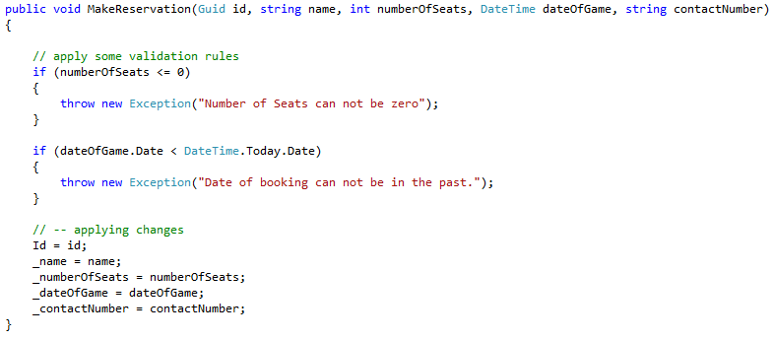
Domain Events
MakeReservation method on exiting domain model.
Notes:
What are Domain Events?
Why should we use Domain Events?
Use Sample 5
Refactor Domain entity – turn Entity into an aggregate by creating a base class called Aggregate.
Demo making changes to the MakeReservation Behavior by separating the concerns of applying business logic and changing state

Slide 22
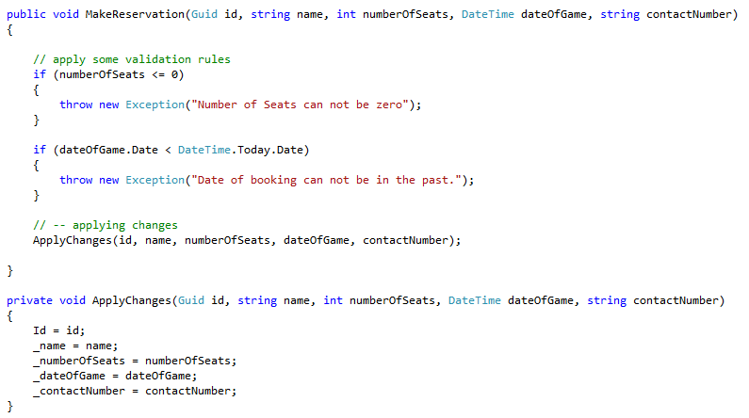
Domain Events
MakeReservation refactor to separate state change and business logic in Domain Object.
Notes:
We can refactor our domain object MakeReservation method by separating the validation/states changed in the Domain distinctively.
We can introduce an ApplyChanges method that will be responsible for the state change.
By doing this we have separated the business rules (invariants) from the change in state.
If we study this code a bit more we can see that ApplyChanges indicates an event has taken place.
Can we model this as an event?
Let refactor this?
This looks very similar to code that we created for the commands, however the intent is very different.
Commands ask the system to do something.
Events are recording that an action has occurred.

Slide 23
Migrating to CQRS
3NF – Database (RDBMS)
3NF – Database (RDBMS)
Events
ORM
ORM
Domain
Domain
CommandHandlers
CommandHandlers
Remote Facade
Remote Facade
Execute Commands
Execute
Commands
Client
Client
Notes:
If we take a moment and look at our evolving stereotypical architecture.
As mentioned previously in the above architecture we are storing the current state of the application in a 3NF database, this is how most systems store data but it is not the only way. Since events represent all changes that have taken place (i.e. all the delta’s in a system) could they be used to reconstruct the current state of the system?
Lets look at an example. Your Wallet

Slide 24

Your Wallet
Event | Transaction | Balance
Start day with £20 | N/A | £20..00
Spend £2 on taxi to work | -2.00 | £18.00
Spend £0.70 on coffee | -0.70 | £17.30
Spend £2.00 on lunch | -2.00 | £15.30
Alice pays you the £5.00 you lent her last week. | +5.00 | £20.30
Spend £0.70 on coffee in afternoon. | -0.70 | £19.60
In your wallet (database) you could store £19.60 ( the current state of your wallet )
Or you could store all the events that have taken place in your wallet, your database then becomes an event store.
Notes:
This is the bases of using event storage and event sourcing.

Slide 25
Event Storage
An event store is designed to store a series of events, also known as an event stream.
Events can be serialized in JSON, Binary, XML etc…
Event store can be
Simple as a file.
noSQL database
Rotational Database Management System
In essence anything that can store a stream of serialized data.
Event Storage gives you an audit log of every change that has taken place in your domain.
Notes:
If our Domain raises events that record all the state changes that have taken place on a domain object can we can reconstruct the state of the domain object by replaying all these events on the domain object to get it back to its current state.
In a moment we will look at how we can create an event store for our sample application – sample6

Slide 26
Event Sourcing
It allows us to preserve every single piece of information about change in data.
It is the process by which a set of events can be applied to an object to get back to its known state.
If your domain emits lots of events then there may be an impact on performance when you try and rehydrate your aggregate from the event store.
In this instance we can use a concept known as Snapshotting
Snapshot prevent the need to read all the events when executing a query to rebuild an aggregate.
Notes:
If our Domain raises events that record all the state changes that have taken place on a domain object can we can reconstruct the state of the domain object by replaying all these events on the domain object to get it back to its current state.
In a moment we will look at how we can create an event store for our sample application – sample6

Slide 27
Domain Events
MakeReservation refactor to separate state change and business logic in Domain Object.
Notes:
The ApplyChanges method here is the logical split in our domain behavior between asking the domain to do something i.e. the MakeReservationCommand and something actually happening. In this case we read the data from the event and just set a few properties on the domain there by changing the state of the domain.
This in itself shows that something has happened i.e. the event has taken place and the state of the domain object has changed or mutated.
But do we really need to store this data on the domain object?
Perhaps – if the data will be required in evaluating an invariant (or business rule on a behavior) then yes. If not then No!
We can merely just set a flag on the Domain object to indicate that its state has changed and store the event in a list that will be persisted to an event store when we ask he repository to save the domain object.
So in the code – back to sample refactor Domain to so that we can store the event in an uncommitted events list and refactor an event store that the repository saves the list of uncommitted events to.

Slide 28
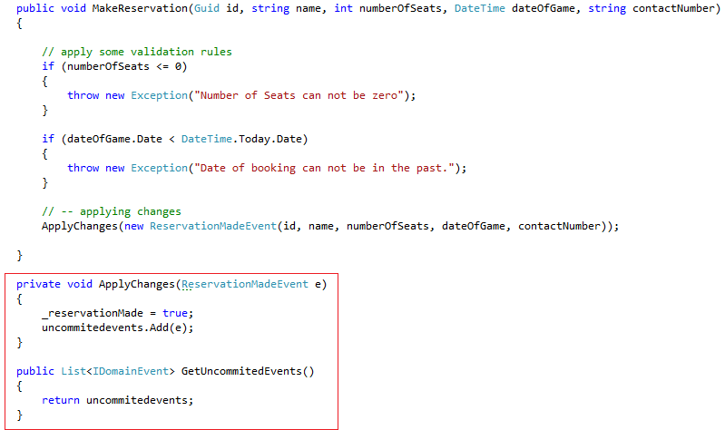
Domain Events
We can record all events that are applied to the aggregate in a list.
When we save the aggregate the events will be read from the list and persisted to an event store.
Notes:
The ApplyChanges method here is the logical split in our domain behavior between asking the domain to do something i.e. the MakeReservationCommand and something actually happening. In this case we read the data from the event and just set a few properties on the domain there by changing the state of the domain.
This in itself shows that something has happened i.e. the event has taken place and the state of the domain object has changed or mutated.
But do we really need to store this data on the domain object?
Perhaps – if the data will be required in evaluating an invariant (or business rule on a behavior) then yes. If not then No!
We can merely just set a flag on the Domain object to indicate that its state has changed and store the event in a list that will be persisted to an event store when we ask he repository to save the domain object.
So in the code – back to sample refactor Domain to so that we can store the event in an uncommitted events list and refactor an event store that the repository saves the list of uncommitted events to.

Slide 29

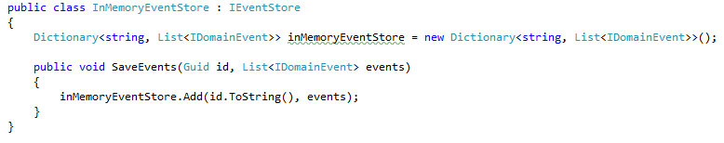
Event Store
Notes:
Just as a recap what our event store look like right now?
We can persist event to it, but we also need to be able to read the events back so that we can rehydrate the domain object.
If we just debug through our code and see the flow from sending a command and then having the domain raise the event.
Sample 7 reading from the event store to rehydrate the domain object.

Slide 30
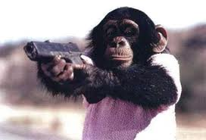
Don’t give your gun to the monkey

Slide 31
Read Model
Notes:
Approaches to the read model
Push model
Pull model

Slide 32
Eventual Consistency
Notes:
CAP Theorem

Slide 33
Other Concerns
Command Dispatchers
http://thinkbeforecoding.com/post/2009/11/03/Event-Sourcing-and-CQRS-Dispatch-options
Event Publishing
Notes:
CAP Theorem

Slide 34
SAGA
Notes:
What are they?
Example
NServiceBus/MassTransit

Slide 35
Testing
Behavior -Driven Development
If is quite often convenient to describe the Domain using Behavior-Driven Development (BDD) story and scenarios templates.
E.G of BDD story template
Story: A person wants to make a Reservation for a football game
As a person wanting to see a football match
I want to make a reservation
So that I can see the game.
Notes:
Behavior-Driven Development story and scenario template.
The BDD story template.
This allows both developers and domain experts to arrive at a common language that will keep appearing in the use cases. The BDD stories are iteratively reviewed to refine out the command language, the Ubiquitous Language.

Slide 36
Summary
Summarization
Notes:
Summarize presentation content by restating the important points from the lessons.
What do you want the audience to remember when they leave your presentation?
Save your presentation to a video for easy distribution (To create a video, click the File tab, and then click Share. Under File Types, click Create a Video.)

Slide 37
Resources
<Additional reading material text here> <hyperlink here>
<Additional reading material text here> <hyperlink here>

Slide 38
Questions?

Slide 39
Challenge of Modeling
Trying to keep your model simple and understandable.
Number of associations between objects should be reduced as much as possible.
Model in a behavior driven way – think about the behavior of your aggregates.

